Slide 1
Data Analysis of Tesla and Google Stock in 2020-2022
-DAMG 6105
-Jie Nan, Li Xiong

Slide 2
Importance to analyze stock data
-Stock data reflect the business performance of this company
- We can predict the value and future performance of an investment
- Make a better decision if we get an offer

Slide 3
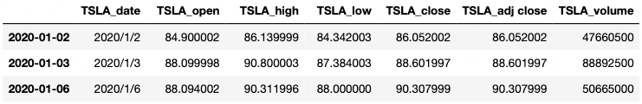
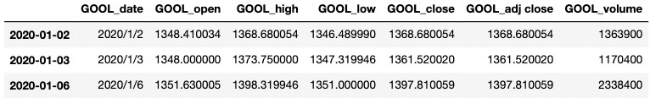
Dataset Introduction
Source: kaggle
Data for Comparison: Daily stock price and volume from 01/2020 to 03/2022 for Tesla and Google

Slide 4


Industry | Automotive & Renewable energy | Artificial intelligence,Advertising,Cloud computing,Computer software,Computer hardware,Intenet
Headquarter | Austin, TX | Mountain View, CA
Founded Time | 1/3/2007 | 9/4/1998
Offering Date | 6/29/2010 | 8/19/2004
Market Capitalization | 1.062Trillion | 1.7Trillion
Number of employees | 110k | 140k
Number of Offices | 16 | 70
Products | Automotive, Solar Roof, Powerwall | Web-based products, Developer tools, Operating systems, Desktop appliances, Mobile applications, Hardware, Services

Slide 5
Content
Close Price Contrast
Daily Volume
Daily Fluctuation Contrast
PBV
Stock Synchronization
MA30 & MA100

Slide 6
Close Price Analysis

Slide 7
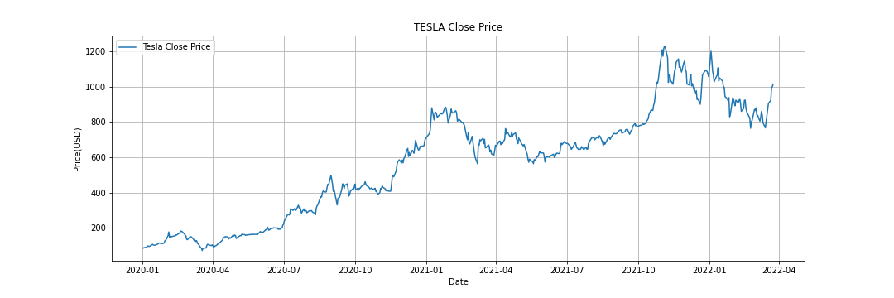
Grow fast
Turbulent, full of ups and downs
2020.08: 2 for 1 split
2020.11: S&P500 accepted Tesla for inclusion after five consecutive quarters of profit of Tesla
2021.02-2021.05: Tesla tumbled due to the Bitcoin
2021.10: Tesla had a new deal with hertz made Tesla the first automaker to reach $1T market cap

Slide 8
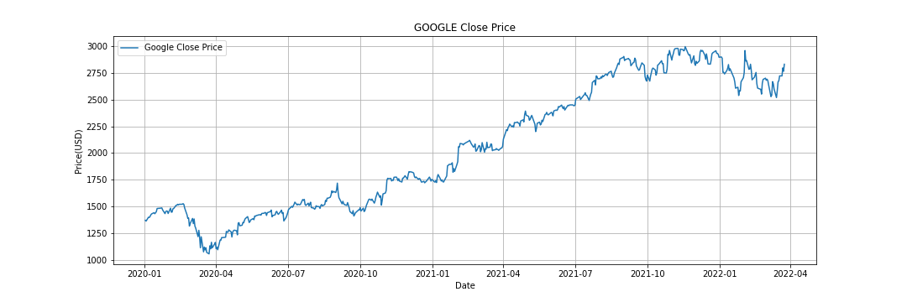
High value,the stock price substainable growth
2020.03: Stock price fell 13% in March caused by the COVID-19, alphabet was losing business.
2021: Price surged by 65%.
2022.02: A new lawsuit abount antitrust was launched against Google. the stock fell 5%.
2022.02: Alphabet anounced a 20:1 stock split

Slide 9
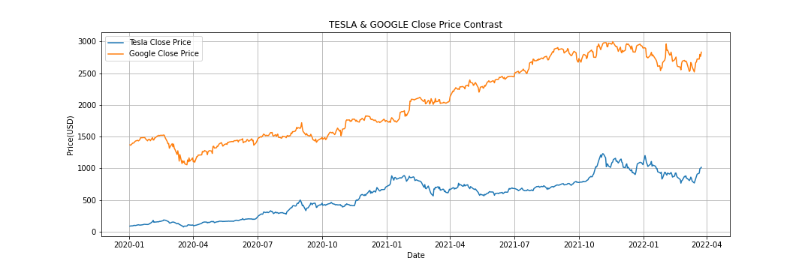
The stock price for Google is much higher than Tesla stock, and Google also increased more than Tesla
In the long term, the two stocks keeps growing
Though unpredictable, the stock price will still grow afterward

Slide 10
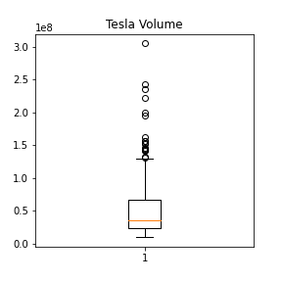
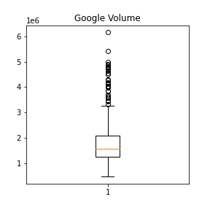
Daily Volume
Trading Volume is measured in the number of shares traded.
The average volume for Tesla is 40 million while 1.5 million for Google
More outliers for Google than for Tesla.

Slide 11
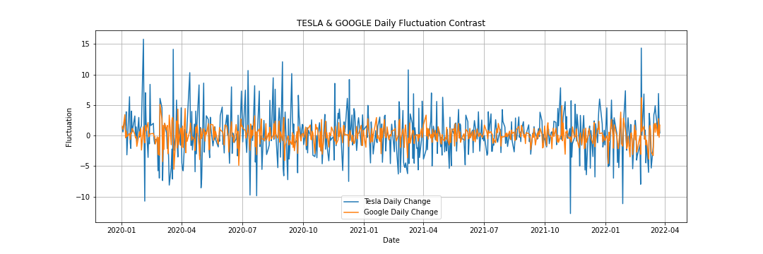
Daily Fluctuation Contrast
Tesla’s stock price floating ratio increased or decreased by about 15%. But Google’s stock increased or decreased by just around 5%.
On the some day,the stock price fluctuation rate for Tesla is higher than Google.Google’s stock price is more steady than Tesla’s.
But you may lose the same amount of money.

Slide 12
PBV
PBV shows the volume of shares traded at a specific price level, it often used to predict areas of support and resistance.
Volume can be used to confirm the direction of a trend.
Volume increases and prices fall, volume decreases and prices increase -> be careful of the reversal market
Volume and prices both increase -> the market is hot and can make profit
Volume and prices both decrease -> unpredictable market

Slide 13
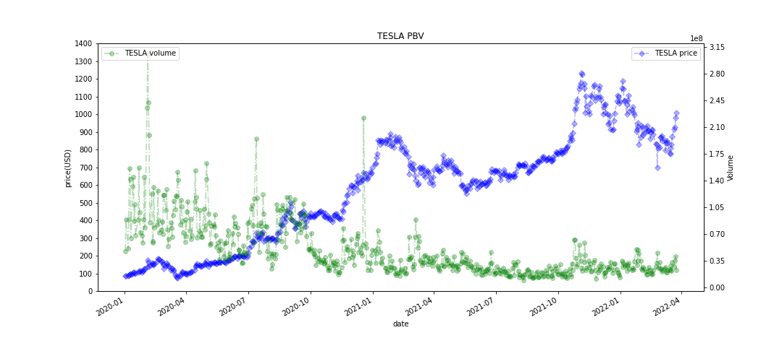
In 2020, Volume is large and stock price keeps increasing, so the market is hot and good for investment
From 2021, price has reached a high peak, more and more people will wait and see
Due to stock history and company’s prospects, people will believe on Tesla

Slide 14
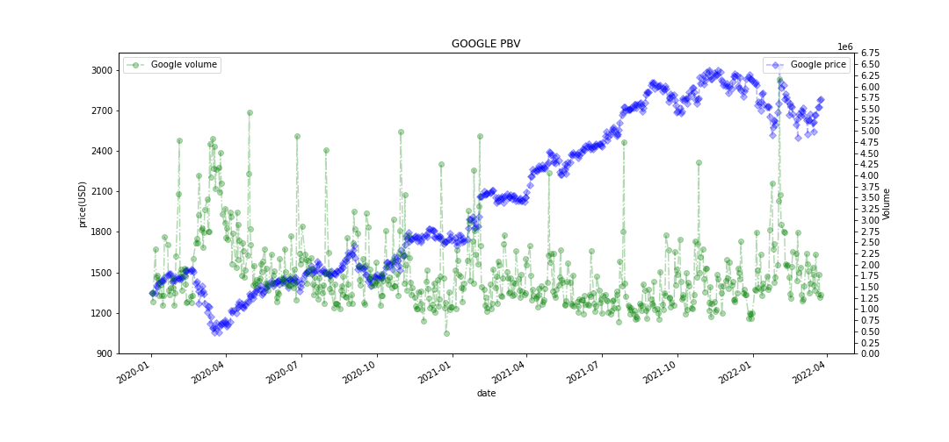
In 2020.04, the price slumped due to the COVID, and the volume is high because of the slump of the price
Volume fluctuation is active may reflect people’s confidence on Google

Slide 15

Stock Synchronization
Stock Synchronization shows the situation that the stock market display significant comovement
High-tech industry are easy to be impacted by same factors.
Single company remains diffrent due to the specific products and company policy.

Slide 16
MA30 & MA100
MA: Moving Average, it represents the average cost of buying stocks in a period of time,reflecting the strength and running trend of stock prices in a certain period of time.
MA30: A short-term technical indicator of stock prices action. It shows the average of closing prices over the last 30 days.
MA100: A long-term technical indicator of stock prices action.It shows the average of closing prices over the last 100 days.
MA30 is not that smooth as MA100

Slide 17
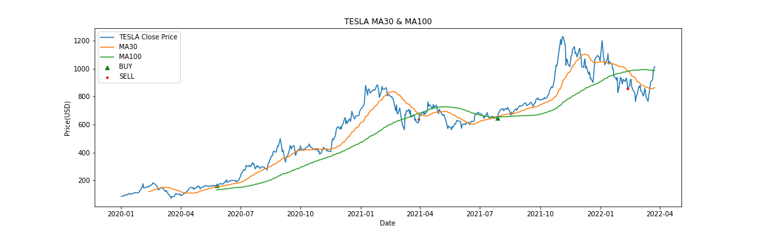
Mostly MA100 is under MA30
When MA100 is under MA30, the trend of the stock is rising
When MA30 is under MA100, the stock is possible to drop
MA30, MA60, MA120, MA200, etc

Slide 18
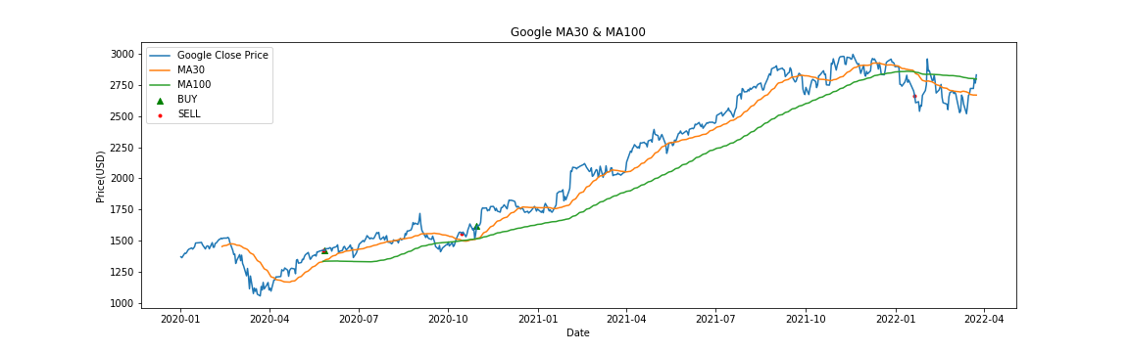
For Google, the MA30 and MA100 tell us we can hold this stock for long-term until recently.

Slide 19
Insight

Slide 20
By analyzing stock data, we know better how a company will develop and how can we choose the company to work.
Stock Market is tubulant and unpredictable, a lot of factors may have impact on the stock price. So predicting a stock is complex.
Investment has certain risks, be wised with your decision.

Slide 21
Reference
https://www.angelone.in/knowledge-center/online-share-trading/30-day-moving-average
https://www.fidelity.com/viewpoints/active-investor/stock-volume
https://investorplace.com/2022/01/alphabet-stock-dropped-nearly-5-on-thursday-but-theres-no-need-to-panic/
https://www.tradingview.com/symbols/NASDAQ-TSLA/history-timeline/
https://www.investopedia.com/terms/p/pricebyvolume.asp
https://en.wikipedia.org/wiki/Tesla,_Inc.
https://en.wikipedia.org/wiki/Google
https://www.kaggle.com/datasets/varpit94/tesla-stock-data-updated-till-28jun2021
https://www.kaggle.com/datasets/varpit94/google-stock-data

